Slide 1

Pet Haven
Sign Up
#Home page
Make your house a home, adopt a pet
About us The online pet adoption community where people who want to adopt a pet connect with people who need to rehome a dog or cat.

Slide 2
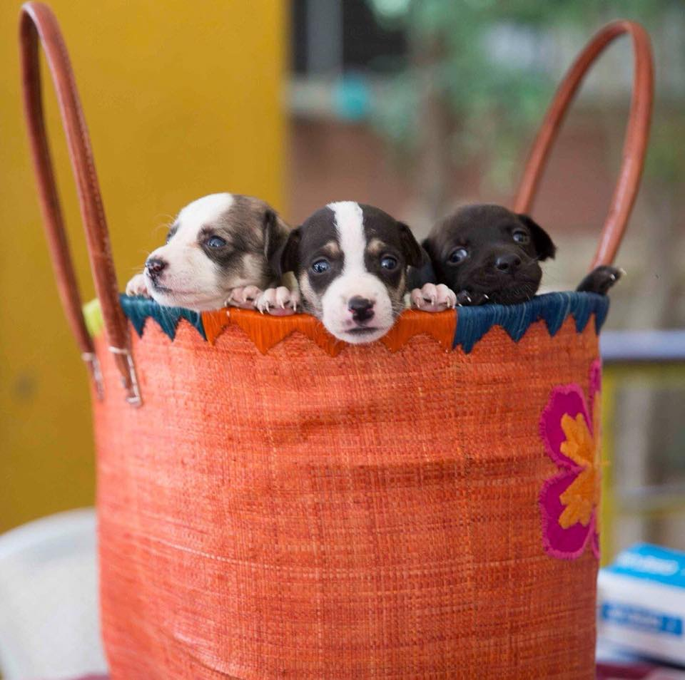
Adopt Me
HomePage Middle Part

Slide 3
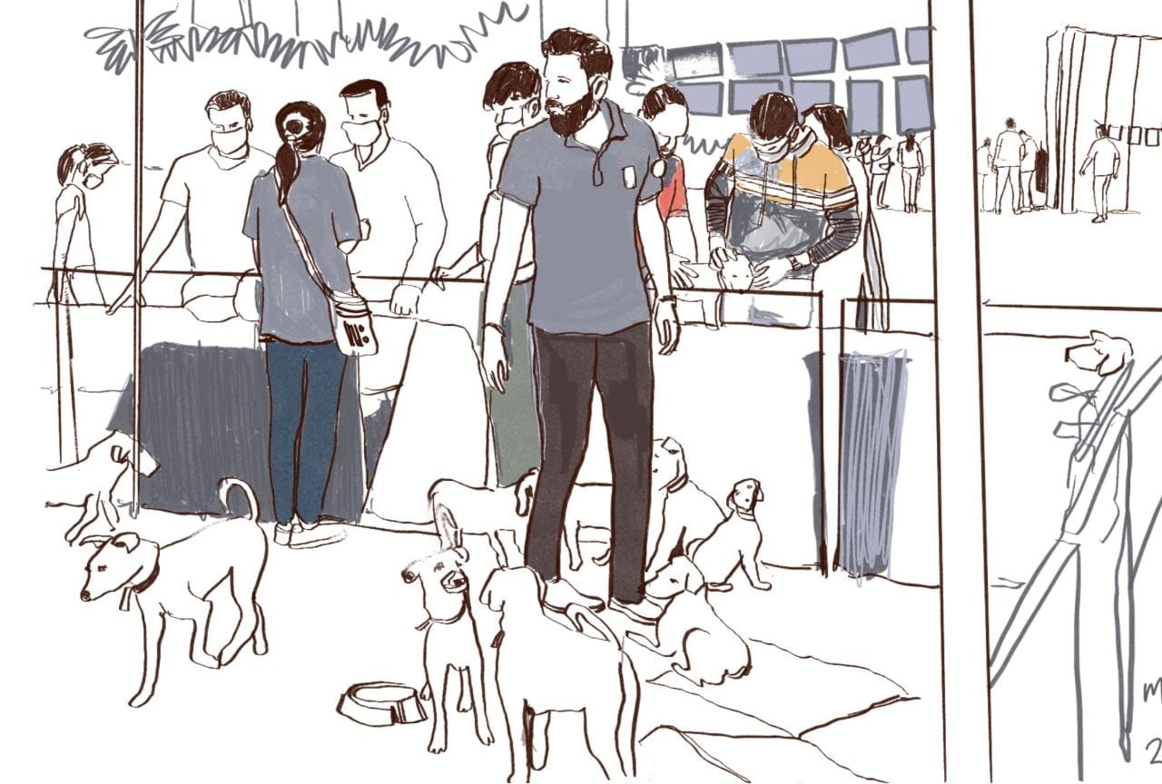
HomePage Middle Part
Approximately 1000+ dogs & cats die every day on road in India. Our mission to provide every dog and cat a home before . Join Our Community and help setting up Pet houses in your surrounding for strays.

Slide 4
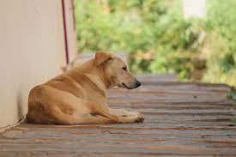
Search To find Your New Pet
#Home page
Search Your Dog
Search Your Cat
Need to rehome a pet?
Click here

Slide 5

Donate
home page bottom
There are many ways you can help us. From covering medical costs and post-op care for animal rescues, sponsoring vaccination shots, celebrating an occasion by sponsoring a meal for our inmates at the animal hospital and at the animal sanctuary or even contributing to help us keep the facilities running , the choice is yours.
Click Here

Slide 6

home page bottom
About Us
Blog
Reviews
Donate
Terms & Conditions

Slide 7



home page bottom
Connect with US
FaceBook
Instagram
Twitter

Slide 8
Sign Up
After click on SignUp
Add Name
Add Email
Create your Password

Slide 9
After click on search your dog result shows on display
Filter
Pet Type
Enter Your State
Enter Your City

Slide 10
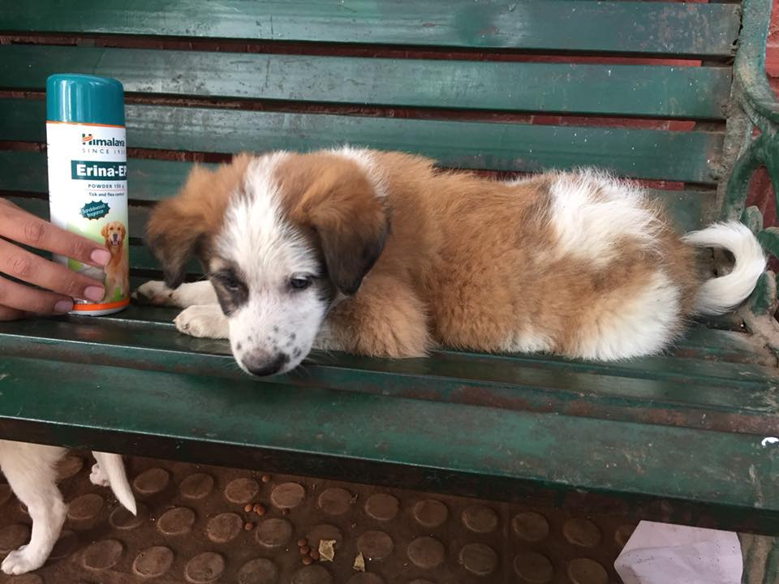
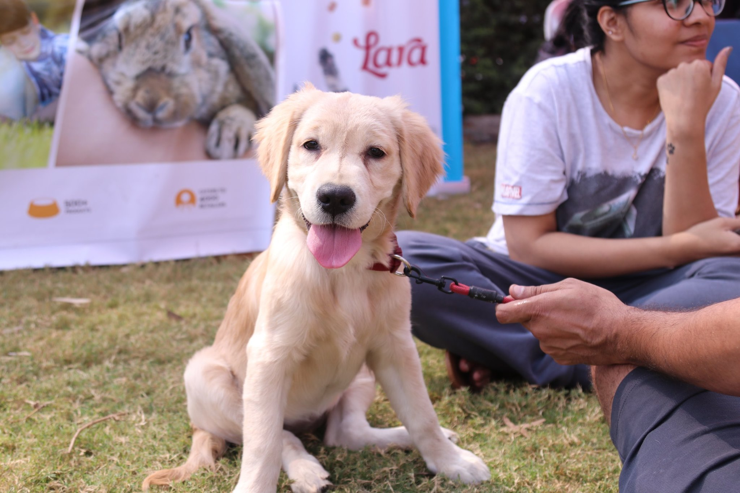
After Enter the Filter ...result shows on display
Available Dogs For Adoption
Dog Name : Max
Dog Age : 6month
Gender : Male
Pet ID :A12
Vaccination :Yes Or No
Dog Name : Rocky
Dog Age : 3Month
Gender :Male
Pet ID :B12
Vaccination : Yes Or No
Click Here
Click Here

Slide 11
After Select Dog :result shows on display
Owner Information
Name : XYZ
Address: Pune
Contact : 987654321

Slide 12
Terms & Conditions
After Select T & C : result shows on display
Your use of the Platform and services and tools are governed by the following terms and conditions ("Terms of Use") as applicable to the Platform including the applicable policies which are incorporated herein by way of reference. It shall be deemed that by accessing, browsing, visiting, or transacting in whatsoever nature / way on the Platform, you unconditionally accept all the Terms of Use and Privacy Policy applicable to the platform specified therein. If you access, browse, visit, or transact in whatsoever nature / way on the Platform, you shall be subject to the policies that are applicable to the Platform for such transaction. By mere use of the Platform, you shall be contracting with Petdos Online Private Limited and these terms and conditions including the policies constitute your binding obligations, with Petdos.

Slide 13

After Click on Blog
Caring For Community Animals During Diwali – What To Do
Here’s what we can do :
Help animals stay hydrated to overcome stress and anxiety.
The sudden light, noise and air pollution cause a lot of distress to animals and birds. Placing a bowl of water outside our houses keeps them hydrated and helps ease their anxiety for a while.
You can also keep the gates of your house and parking lot open to provide a safe place for scared animals to shelter, should they need it.
Protect animals from getting electric shocks.
The hanging lights tempt animals and birds to come close and touch them. Make sure there are no open or loose-fitted wires that can result in them getting electric shocks, even leading to their death.

Slide 14
Reviews
After click on reviews :result shows on display

